Slide 1
Objects
Objects and Properties | Methods | Accessor Properties | Passing Objects to Functions
Notes:
Welcome to our lecture on Objects. In this lecture we will go through objects and their properties, methods, accessor properties, how to pass objects to functions. Let’s start our lecture.

Slide 2
Objects and Properties
Objects: An object is an unordered collection of properties, where each property is a name-value pair.
Object Properties: The property name is an identifier, and the value can be of any data type.
Object Literal: Objects are often defined using an object literal (or initializer), which is a comma-separated list of property name-value pairs.
Notes:
In this lecture, we explore objects and their properties. An object is an unordered collection of properties, each being a name-value pair. Property names are identifiers, and values can be any data type. Objects are often defined using object literals, which are comma-separated lists of these name-value pairs. This structure allows for flexible and organized data representation in programming.

Slide 3
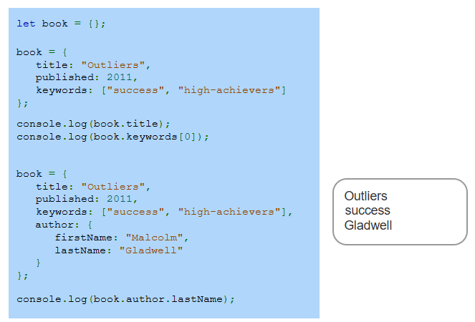
Example
Notes:
This example demonstrates creating and modifying a JavaScript object. First, an empty object is initialized. The object is updated with properties like title, published year, and an array of keywords. Using console.log, we access the title and the first keyword. Later, an author property with nested values is added, and we log the last name. This highlights working with nested objects and accessing their properties.

Slide 4
Methods
Creating Methods: Assigning an anonymous function to an object's property name creates a method.
Accessing Properties: Methods can access the object's properties using the keyword this, followed by a period and the property name.
Example: To access a property, use this.someProperty within the method.
Notes:
Building on what we learned about objects, let us now focus on methods. A method is created by assigning an anonymous function to an object's property. These methods can access the object's properties using the keyword this, followed by a period and the property name. For instance, use this.propertyName within a method to reference an object property. This highlights object functionality in action.

Slide 5
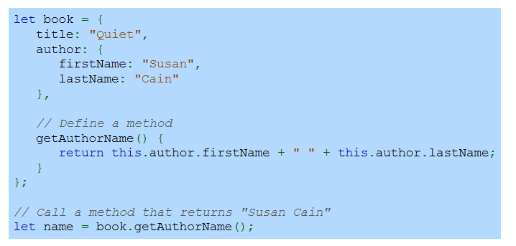
Defining Method In An Object Literal
Notes:
Now that we understand methods, let us see how to define one in an object literal. Here, we create an object with properties such as title and author, which itself is a nested object. A method, getAuthorName, is defined to return the author's full name by accessing the nested properties using this. When we call this method, it returns the name Susan Cain, demonstrating how methods work within objects.

Slide 6
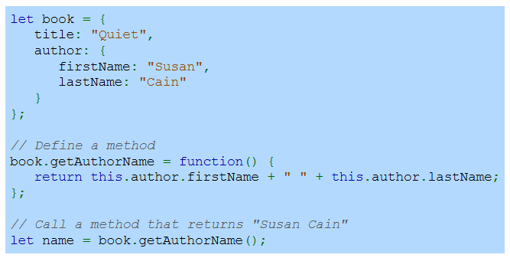
Defining A Method For An Existing Object
Notes:
Building on the previous slide, here we define a method for an existing object. The book object has properties like title and author. We add the getAuthorName method to it using a function expression. This method accesses the nested author properties using this and returns the full name. When called, the method outputs Susan Cain. This approach allows adding functionality to objects dynamically.

Slide 7
Accessor Properties
Accessor Properties: Object properties that use a getter, a setter, or both.
Getter: A function executed when a property is retrieved. Syntax: get property() { return some Value; }.
Setter: A function executed when a property is set. Syntax: set property(value) { ... }.
Purpose: Used for computed properties or to validate data when setting a property.
Notes:
Moving forward, let us discuss accessor properties. These are object properties that use getter or setter functions or both. A getter runs when a property is accessed, using the syntax get property. Similarly, a setter runs when a value is assigned, using set property(value). Accessor properties are useful for computed values or for validating data when setting properties, adding dynamic behavior to objects.

Slide 8
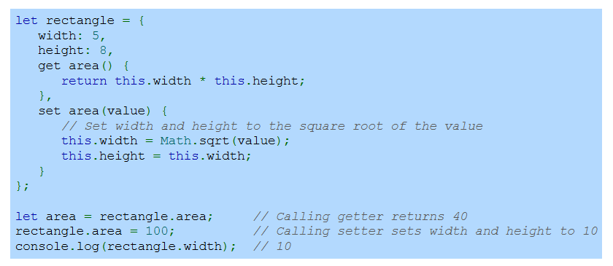
Defining an accessor property called 'area'
Notes:
Let us see an example of accessor properties with a rectangle object. The getter for area calculates and returns width times height. The setter allows setting a new area value, updating both width and height to the square root of the value. Calling rectangle.area invokes the getter, and assigning a value to it invokes the setter. This demonstrates dynamic behavior using get and set for object properties.

Slide 9
Passing objects to functions
JavaScript data types can be divided into two categories: primitives and references.
A primitive is data that is not an object and includes no methods. Primitive types include Boolean, number, string, null, and undefined.
A reference is a logical memory address. Only objects are reference types.
Notes:
Transitioning to data types, JavaScript divides them into primitives and references. Primitives include Boolean, number, string, null, and undefined. These are not objects and have no methods. References, on the other hand, point to a logical memory address and apply only to objects. When passing objects to functions, the reference is passed, allowing changes to affect the original object.

Slide 10
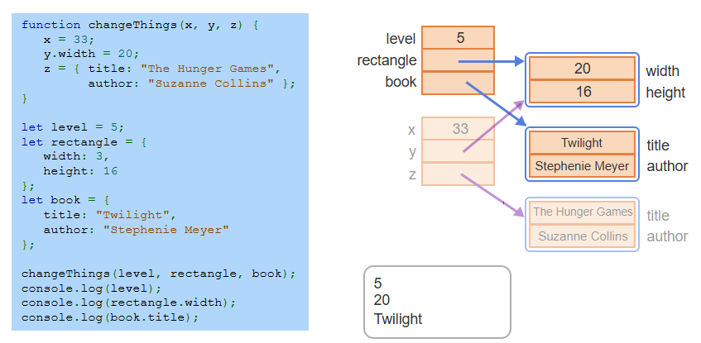
Passing primitives and references to a function
Notes:
Let us explore passing primitives and references to a function. Here, primitives like level are passed by value, so changes inside the function do not affect the original. However, objects like rectangle and book are references, so modifying them inside the function affects the original object. This distinction between value and reference types is crucial when working with functions in JavaScript. Thanks for watching the lecture.

